Slide 1

Attribution
and CoolTShirts.com
Learn SQL from Scratch
B.G. Taft
3.15.19

Slide 2
Example Table of Contents
Get familiar with CoolTShirts
What is the user journey?
Optimize the campaign budget

Slide 3
1. Get familiar with CoolTshirts

Slide 4
1.1 Understanding Sources and Campaigns
How many campaigns and sources does CoolTShirts use and how are they related?
CoolTShirts is currently running 8 campaigns and pulling traffic from 6 distinct sources. Each campaign relates to a specific source, while some sources are the subject of multiple different campaigns.
"utm_source”, or Source, tells us which touchpoint sent traffic to CoolTshirts, while “utm_campaign”, or Campaign, allows us to attribute traffic to particular ads or marketing emails.
Source | Campaign
nytimes | getting-to-know-cool-tshirts
email | weekly-newsletter
buzzfeed | ten-crazy-cool-tshirts-facts
email | retargetting-campaign
facebook | retargetting-ad
medium | interview-with-cool-tshirts-founder
google | paid-search
google | cool-tshirts-search
SELECT COUNT (DISTINCT utm_source),
COUNT (DISTINCT utm_campaign)
FROM page_visits;
SELECT DISTINCT utm_source AS Source,
utm_campaign AS Campaign
FROM page_visits;

Slide 5
1.2 Understanding CoolTShirts.com
What pages are on CoolTShirts.com’s website? How are they organized for tracking purposes?
There are 4 pages being tracked in this data set, as seen in the table below.
A user who has completed a purchase must visit each of these pages at least once. See the Page Loads column below to get a sense for the number of
SELECT page_name AS Page ,
COUNT (timestamp) AS 'Page Loads'
FROM page_visits
GROUP BY 1;
Page | Page Loads
1 - landing_page | 2000
2 - shopping_cart | 1900
3 - checkout | 1431
4 - purchase | 361

Slide 6
2. What is the User Journey?

Slide 7
2.1 Campaign Metrics – First Touches
How many first touches is each campaign responsible for?
Campaign | Total
cool-tshirts-search | 169
ten-crazy-cool-tshirts-facts | 576
getting-to-know-cool-tshirts | 612
interview-with-cool-tshirts-founder | 622
WITH first_touch AS (
SELECT user_id,
MIN(timestamp) AS first_touch_at
FROM page_visits
GROUP BY user_id),
first_source AS (
SELECT ft.user_id,
ft.first_touch_at,
pv.utm_source,
pv.utm_campaign
FROM first_touch ft
JOIN page_visits pv
ON pv.user_id = ft.user_id
AND pv.timestamp = ft.first_touch_at)
SELECT first_source.utm_campaign AS Campaign,
COUNT (*) AS "Total First Touches"
FROM first_source
GROUP BY 1
ORDER BY 2 ASC;

Slide 8
2.2 Campaign Metrics – Last Touches
Campaign | Total
cool-tshirts-search | 60
paid-search | 178
interview-with-cool-tshirts-founder | 184
ten-crazy-cool-tshirts-facts | 190
getting-to-know-cool-tshirts | 232
retargetting-campaign | 245
retargetting-ad | 443
weekly-newsletter | 447
How many last touches is each campaign responsible for?
Last touches come from a wider variety of campaigns, as retargetting and email campaigns enter the picture.
WITH last_touch AS (
SELECT user_id,
MAX(timestamp) AS last_touch_at
FROM page_visits
GROUP BY user_id),
last_source AS (
SELECT last_touch.user_id,
last_touch.last_touch_at,
page_visits.utm_source,
page_visits.utm_campaign
FROM last_touch
JOIN page_visits
ON page_visits.user_id = last_touch.user_id
AND page_visits.timestamp = last_touch.last_touch_at)
SELECT last_source.utm_campaign AS Campaign,
COUNT (*) AS "Totals Last Touches"
FROM last_source
GROUP BY 1
ORDER BY 2;

Slide 9
2.3 Campaign Metrics – Purchases
How many customers made a purchase?
Page | Page Loads
4 - purchase | 361
SELECT page_name AS Page ,
COUNT (timestamp) AS 'Page Loads'
FROM page_visits
WHERE page_name LIKE '%purchase%';
Total | Campaign
115 | weekly-newsletter
113 | retargetting-ad
54 | retargetting-campaign
52 | paid-search
9 | getting-to-know-cool-tshirts
9 | ten-crazy-cool-tshirts-facts
7 | interview-with-cool-tshirts-founder
2 | cool-tshirts-search
How many last touches on the purchase page is each campaign responsible for?
SELECT COUNT (*),
utm_campaign
FROM page_visits
WHERE page_name LIKE '%purchase%'
GROUP BY utm_campaign
ORDER BY 1 DESC;

Slide 10
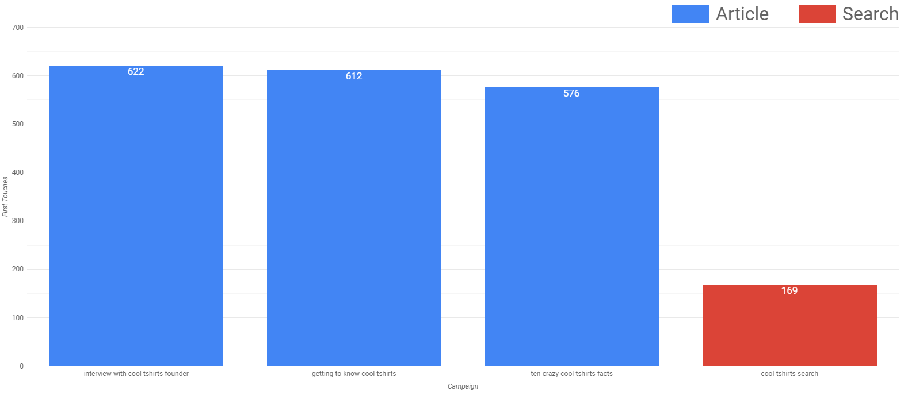
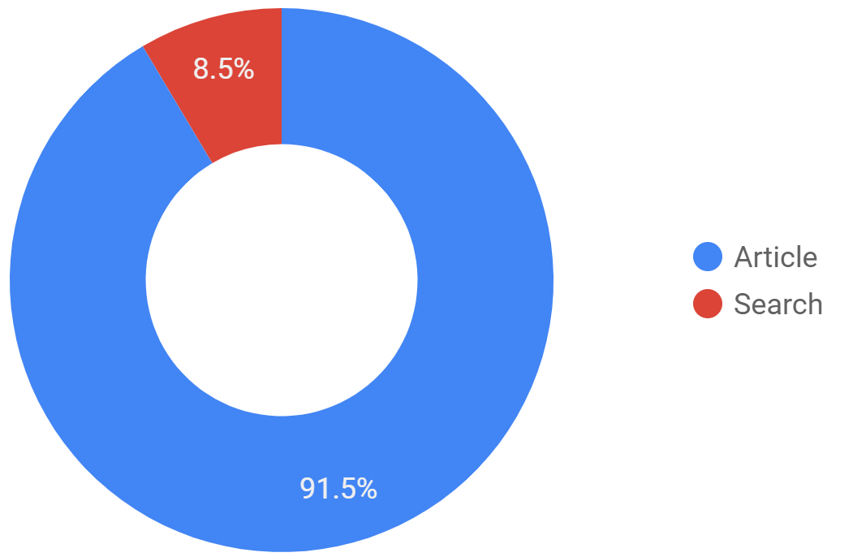
2.4 Typical User Journey
The typical user journey sees users connecting to CoolTShirts.com via one of several advertising campaigns connected to popular websites (blue columns) or via search traffic (red).
As can be seen, the 91.5% of first touches are arriving via links emmanating from articles placed on popular websites.

Slide 11
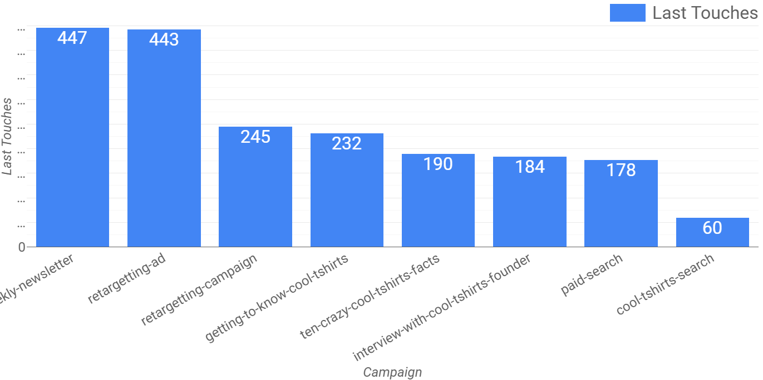
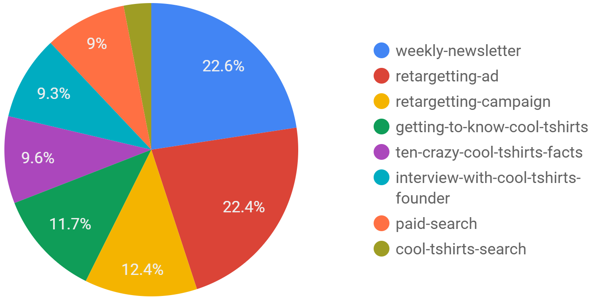
2.5 Typical User Journey - Last Touches
The typical user journey ends very differently. After assigning attribution to last touches, we can see the effectiveness of efforts to re-contact users who have already engaged with CoolTShirts.com.
The Weekly Newsletter and Retargetting Ads lead the way.

Slide 12
3. Optimize the Campaign Budget

Slide 13
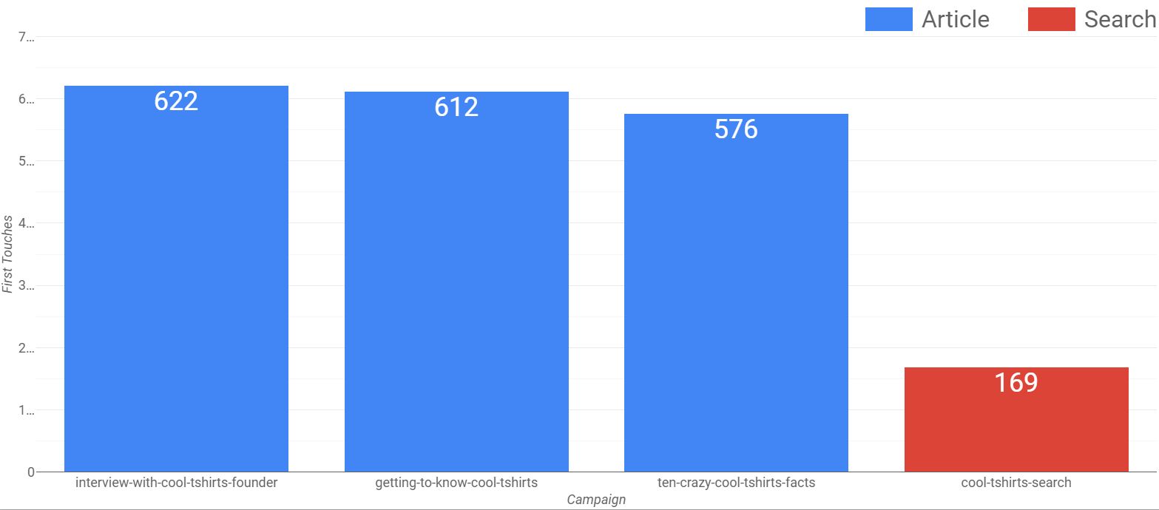
3.1 Optimization – Making First Contact
To optimize first contacts:
Focus on the articles from popular websites that are driving customers to the website.

Slide 14
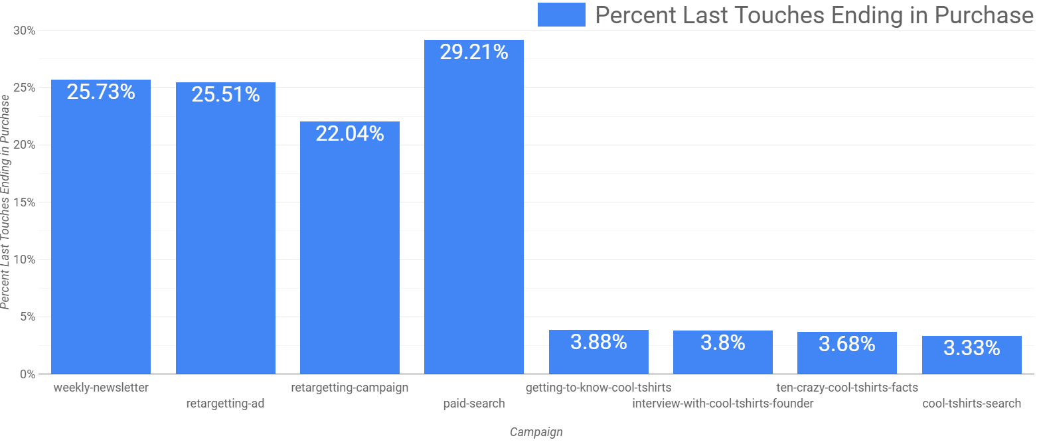
3.2 Optimization – Making The Sale
Let’s check out efficiency of campaigns ability to make the sale. Below we see the percentage of last touch attributions that lead to a purchase. In terms of effectiveness we see one big divide - our four main first-touch campaigns are in one class, while the email, paid search, and re-targeted ads are in another class.

Slide 15
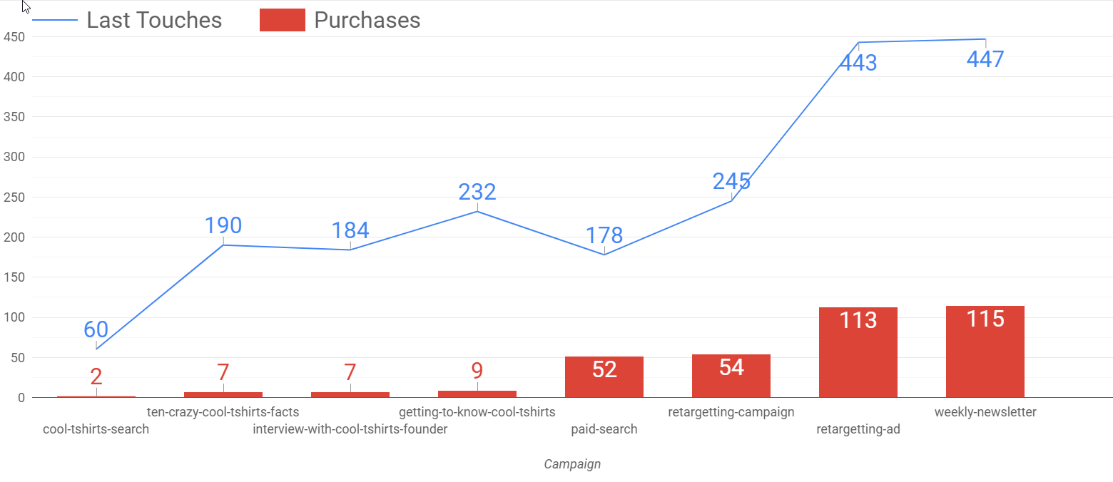
3.3 Optimization – Making The Sale
To optimize efficiency driving toward additional touches leading to purchase:
The two email campaigns – the weekly newsletter and retargeting campaign, show effectiveness at driving customers back to the website and through the purchase process. However, they are likely duplicative – since they both end up in customers’ inboxes. Focus resources on the weekly newsletter (and consider making it a twice weekly?)
Retargeting Ad campaign is a solid money-maker, bringing customers back and purchasing shirts at volume.

Slide 16
3.4 Optimization – In Summary
To optimize the budget toward efficiency from first touch to last:
Invest in the three campaigns that are consistently driving customers to the website for first-touches
Invest in the Weekly Newsletter to drive last-touch/final purchase traffic from customers’ inboxes
Invest in retargeting ads to drive last-touch/final purchase traffic while customers surf the web.

